Slide 1

The Aga Khan Hospital Dar es Salaam
Timeliness in returning Discharge files to Medical Records Q1 - Q3 2022

Slide 2
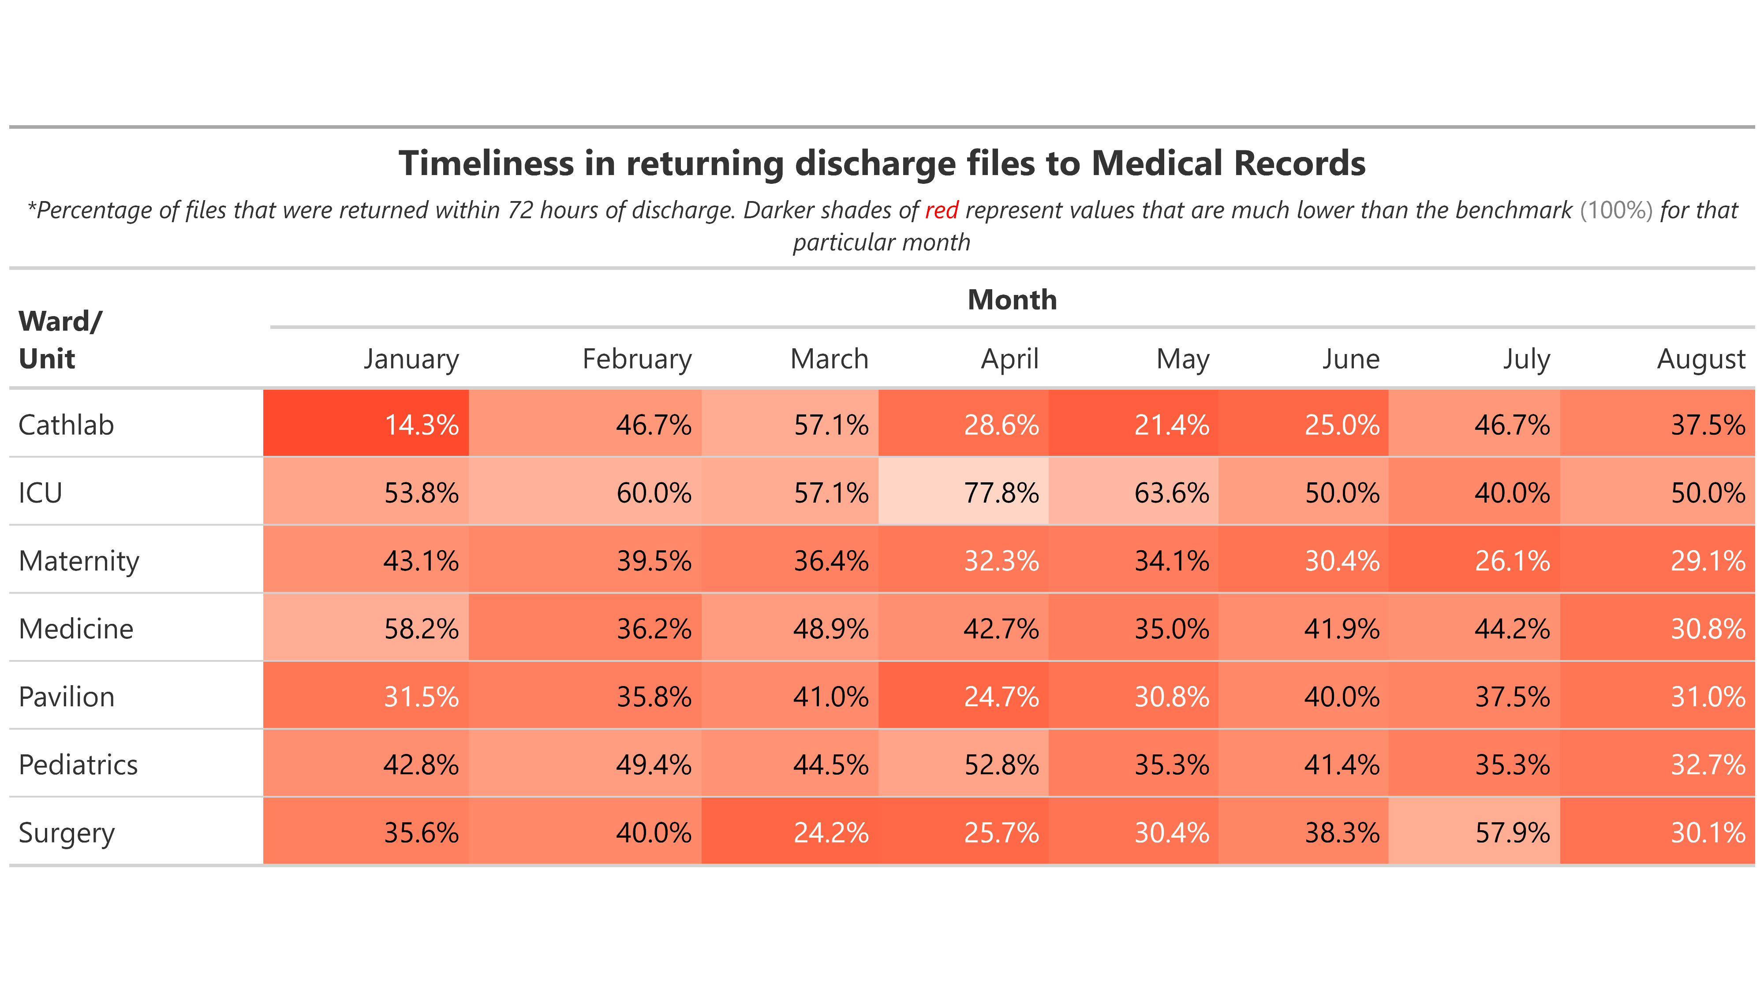

Slide 3
